Slide 1
IBM InfoSphere Information Server
Lesson 2: Designing Jobs

Slide 2
Lesson Objectives
On completion of this lesson, you will be able to:
Understand DataStage designer
Log onto DataStage
Describe the DataStage workflow
Create a Parameter Set
Design a simple Parallel job in Designer
Define a job parameter
Use the Row Generator, Peek, and Annotation stages in a job
Compile your job

Slide 3
IBM InfoSphere Information Server
Lesson 2.1 : Introduction to Designer

Slide 4
Introduction to Designer and Job
The DataStage Designer is the primary interface to the metadata repository and provides a graphical user interface that enables you to view, edit, and assemble DataStage objects from the repository needed to create an ETL job.
An ETL job should include source and target stages. Additionally, your job can include transformation stages for data filtering, data validation, data aggregation, data calculations, data splitting for multiple outputs, and usage of user-defined variables or parameters. These stages allow the job design to be more flexible and reusable.
Notes:
DataStage Designer enables you to:
Create, edit, and view objects in the repository.
Create, edit, and view data elements, table definitions, transforms, and routines.
Import and export DataStage components, such as projects, jobs, and job components.
Analyze the use of particular items in a project.
Edit and view user-defined object properties.
Create jobs, job sequences, containers, and job templates.
Create and use parameters within jobs.
Save, compile, and run jobs.

Slide 5
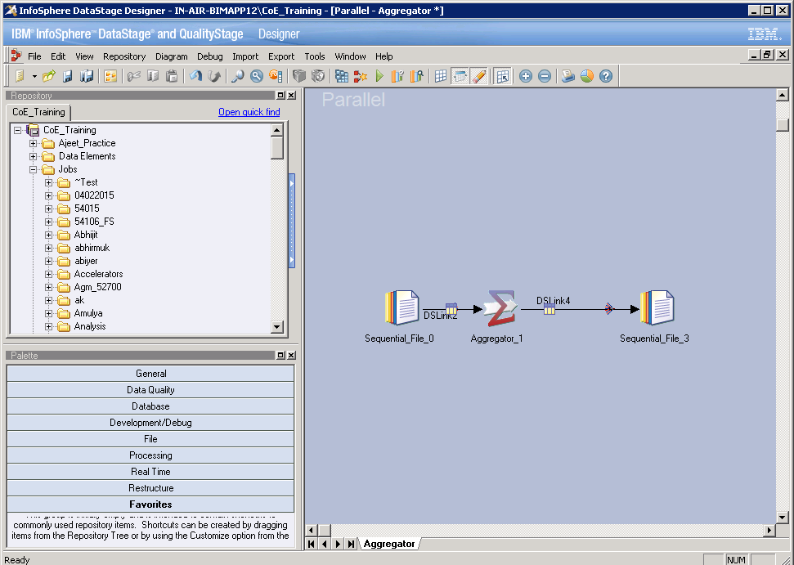
DataStage Designer Window
Notes:
The DataStage Designer window, which is the graphical user interface used to view, configure, and assemble DataStage objects, contains the following components:
Repository Window: Displays project objects organized into categories. By default, the Repository window is located in the upper left corner of the Designer window. The project tree displays in this pane and contains the repository objects belonging to a project.
Tool Palette: Contains objects that you add to your job design, such as stage types, file types, database types, and processor objects. You can drag these objects from the Palette into the Diagram window. By default, this window is displayed in the lower left corner, of the Designer window. This window appears to be empty until you open or create a job.

Slide 6
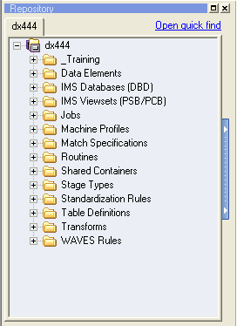
DataStage Project Repository
User-added folder
Standard jobs folder
Standard Table Definitions folder
Notes:
Repository Window: Displays project objects organized into categories. By default, the Repository window is located in the upper left corner of the Designer window. The project tree displays in this pane and contains the repository objects belonging to a project.

Slide 7
IBM InfoSphere Information Server
Lesson 2.2 : Development Workflow and logging into Designer

Slide 8
Development Workflow
Define your project’s properties: Administrator
Open (attach to) your project
Import metadata that defines the format of data stores your jobs will read from or write to
Design the job: Designer
Define data extractions (reads)
Define data flows
Define data integration
Define data transformations
Define data constraints
Define data loads (writes)
Define data aggregations
Compile and debug the job: Designer
Run and monitor the job: Director as well as Designer.

Slide 9
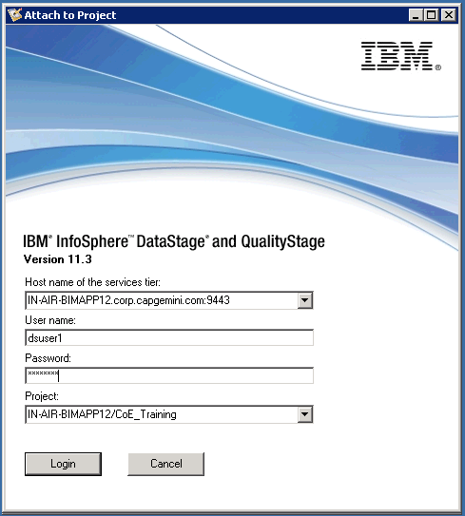
Logging onto DataStage Designer
Host name, port number of application server
DataStage server machine / project

Slide 10
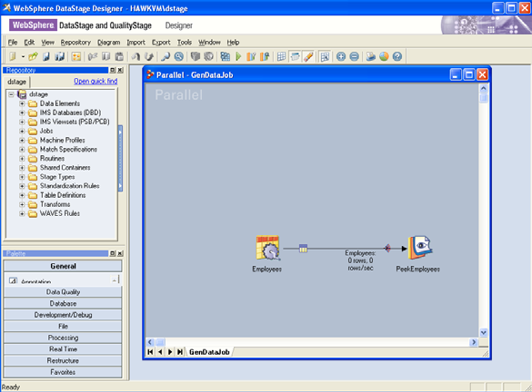
Designer Work Area
Menus
Repository
Parallel canvas
Toolbar
Palette
Notes:
The appearance of the designer work space is configurable; the graphic shown here is only one example of how you might arrange components.
In the right center is the Designer canvas, where you create stages and links.
On the top left is the Repository window.
Items in the Repository, such as jobs and table definitions can be dragged to the canvas area.
Click View>Repository to display the Repository window
On the bottom left is the Tools Palette, which contains stages you can add to the canvas.
Click View>Palette to display the Palette window.

Slide 11
IBM InfoSphere Information Server
Lesson 2.3 : Import metadata into the Repository

Slide 12
Importing Table Definitions
Table Definitions describe the format and columns of files and tables
You can import Table Definitions for:
Sequential files
Relational tables
COBOL files
Many other things
Table Definitions can be loaded into job stages

Slide 13
Importing Table Definitions
Table Definitions define the formats of a variety of data files and tables. These definitions can then be used and reused in your jobs to specify the formats of data stores.
For example, you can import the format and column definitions of the Customers.txt file.
You can then load this into the sequential source stage of a job that extracts data from the Customers.txt file. You can load this same metadata into other stages that access data with the same format. In this sense the metadata is reusable. It can be used with any file or data store with the same format.
If the column definitions are similar to what you need you can modify the definitions and save the Table Definition under a new name.
You can import and define several different kinds of Table Definitions including: Sequential files and ODBC data sources.

Slide 14
Sequential File Import Procedure
To start the import, click Import>Table Definitions>Sequential File Definitions.
The Import Meta Data (Sequential) window is displayed.
Select directory containing sequential file and then the file
The Files box is then populated with the files you can import. Select the file to import.
Select or specify a folder to import into.
Select a repository folder to store the Table Definition in
Examined format and column definitions and edit as necessary.

Slide 15
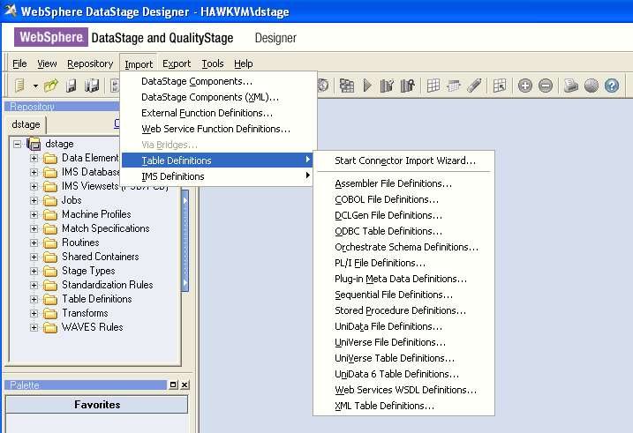
Importing Sequential Metadata
Import Table Definition for a sequential file

Slide 16
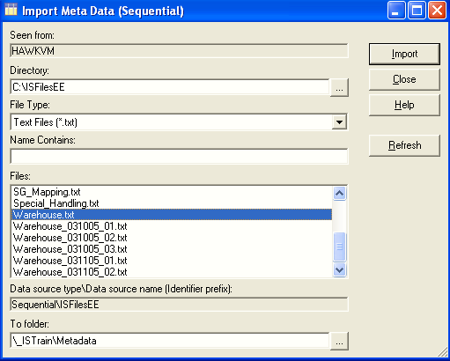
Sequential Import Window
Select directory containing files
Start import
Select file
Select repository folder

Slide 17
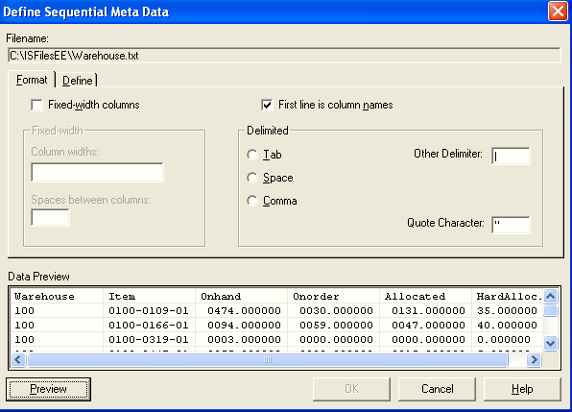
Specify Format
Edit columns
Select if first row has column names
Delimiter

Slide 18
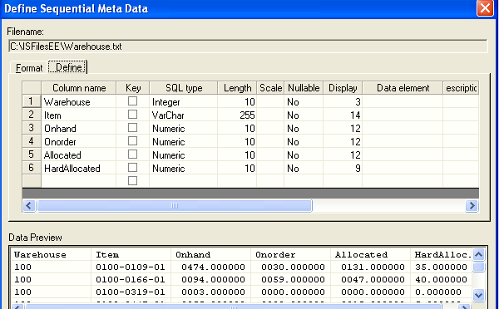
Edit Column Names and Types
Double-click to define extended properties
Notes:
You can also add “Extended Properties”. Double-click on the number to the left of the column name to open up a window in which you specify these extended properties. Extended properties are discussed later in this course.

Slide 19
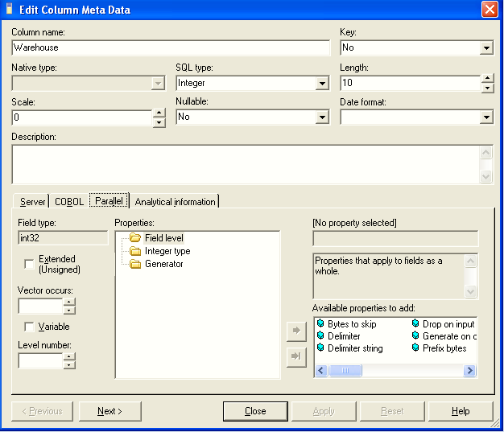
Extended Properties window
Parallel properties
Property categories
Available properties

Slide 20
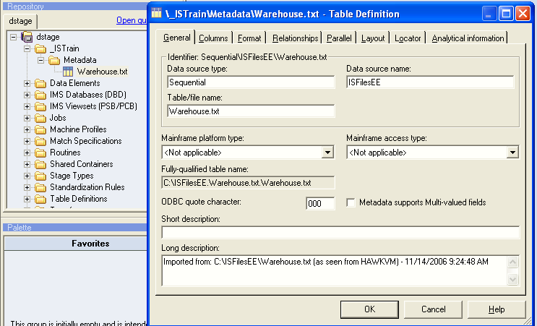
Table Definition General Tab
Type
Source
Stored Table Definition
Notes:
Table Definition General Tab
In the Repository window, select the folder that contains the Table Definition.
Double-click the Table Definition to open the Table Definition window.
Click the Columns tab to view and modify any column definitions.
Select the Format tab to edit the file format specification.
Select the Parallel tab to specify parallel format properties.

Slide 21
IBM InfoSphere Information Server
Lesson 2.4 : Job Parameter and parameter Sets

Slide 22
Job Parameter
Defined in Job Properties window
Makes the job more flexible
Parameters can be:
Used in directory and file names
Used to specify property values
Used in constraints and derivations
Parameter values are determined at run time
When used for directory and files names and property values, they are surrounded with pound signs (#)
–E.g., #NumRows#
Job parameters can reference DataStage environment variables
–Prefaced by $, e.g., $APT_CONFIG_FILE

Slide 23
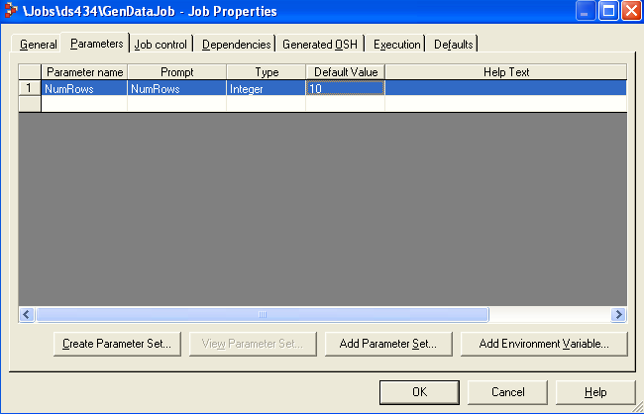
Defining a Job Parameter
Click the Job Properties icon to open this window.
Parameters tab
Add environment variable
Parameter

Slide 24
Parameter Sets
Store a collection of parameters in a named object
One or more values files can be named and specified
A values file stores values for specified parameters
Values are picked up at runtime
Parameter Sets can be added to the job parameters specified on the Parameters tab in the job properties

Slide 25
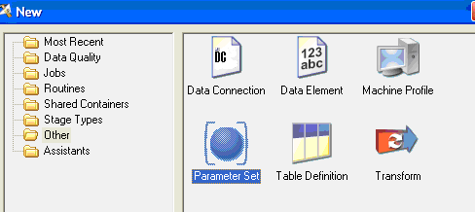
Creating a New Parameter Set

Slide 26
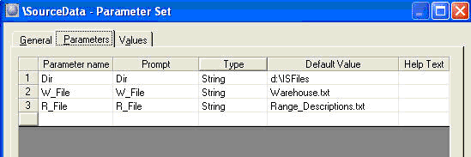
Parameters Tab
Specify parameters
Parameter set name is specified on General tab

Slide 27
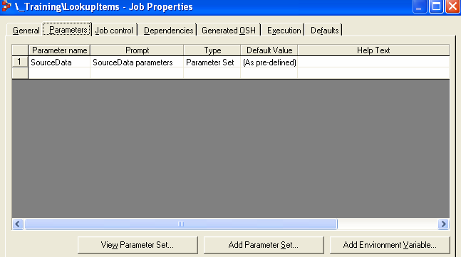
Adding a Parameter Set to Job Properties
View Parameter Set
Add Parameter Set
Parameter Set Reference

Slide 28
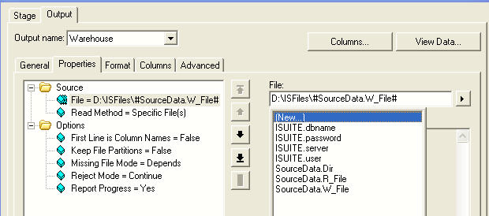
Using Parameter Set Parameters
Select Parameter Set parameters
Notice that Parameter Set parameters are qualified by the name of the Parameter Set.

Slide 29
IBM InfoSphere Information Server
Lesson 2.5 : Creating Parallel Jobs

Slide 30
What Is a Parallel Job?
Executable DataStage program
Created in DataStage Designer
Can use components from Repository
Built using a graphical user interface
Compiles into Orchestrate script language (OSH) and object code (from generated C++)

Slide 31
Job
A job is an executable DataStage program.
In DataStage, you can design and run jobs that perform many useful data integration tasks, including data extraction, data conversion, data aggregation, data loading, etc.
DataStage jobs are:
Designed and built in Designer.
Scheduled, invoked, and monitored in Director.
Executed under the control of DataStage.

Slide 32
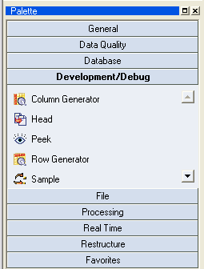
Tools Palette
Stage categories
The tool palette contains icons that represent the components you can add to your job design
Stages

Slide 33
Adding Stages and Links
Drag stages from the Tools Palette to the diagram
Can also be dragged from Stage Type branch to the diagram
Draw links from source to target stage
Right mouse over source stage
Release mouse button over target stage

Slide 34
Job Creation Example Sequence
Brief walkthrough of procedure
Assumes Table Definition of source already exists in the repository

Slide 35
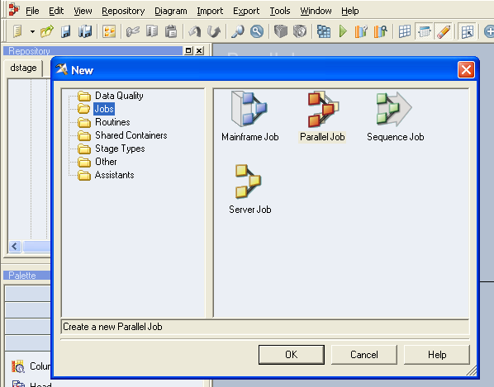
Create New Parallel Job
Click the New button in the toolbar to open the New window. Click on the Parallel Job icon to create a new parallel job (the focus of this course).
Open New window
Parallel job

Slide 36
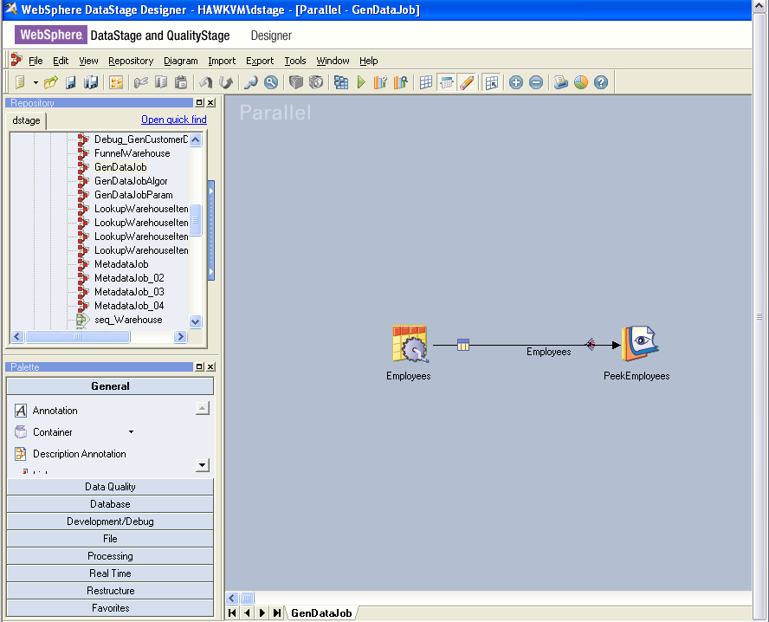
Drag Stages and Links From Palette
Compile
Peek
Job properties
Row Generator
The tools palette may be shown as a floating dock or placed along a border. Alternatively, it may be hidden and the developer may choose to pull needed stages from the repository onto the design work area.

Slide 37
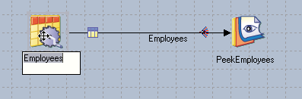
Renaming Links and Stages
Click on a stage or link to rename it
Meaningful names have many benefits
Documentation
Clarity
Fewer development errors

Slide 38
Row Generator Stage
Produces mock data for specified columns
No inputs link; single output link
On Properties tab, specify number of rows
On Columns tab, load or specify column definitions
Open Extended Properties window to specify the values to be generated for that column
A number of algorithms for generating values are available depending on the data type
Algorithms for Integer type
Random
Cycle: Initial value, increment
Algorithms for string type: Cycle , alphabet
Algorithms for date type: Random, cycle

Slide 39
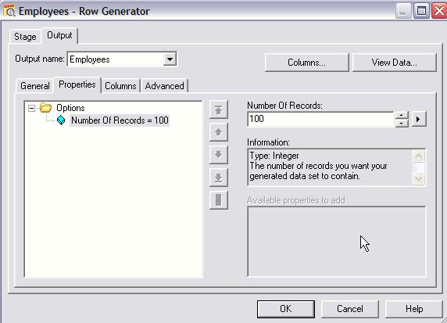
Inside the Row Generator Stage
Properties tab
Property
Set property value

Slide 40
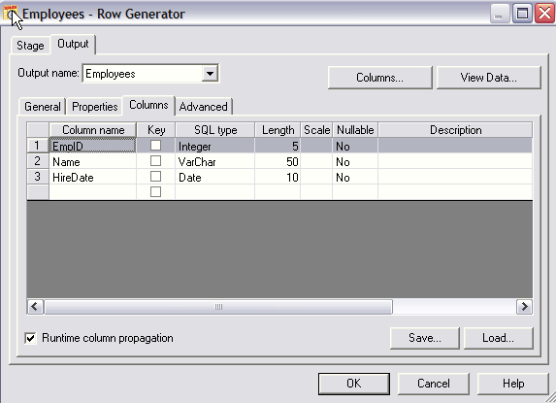
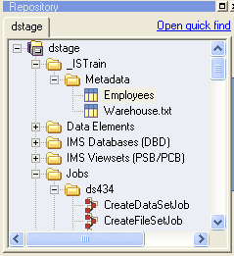
Columns Tab
View data
Double-click to specify extended properties
Load a Table Definition
Select Table Definition
On the Columns tab, define the column definitions. Either manually specify the columns or load the column definitions from a Table Definition. A Table Definition can either be loaded, as shown here, or dragged from the Repository and dropped on the link.

Slide 41
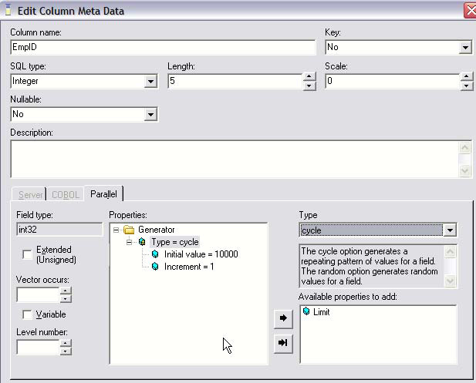
Extended Properties
Specified properties and their values
Additional properties to add
Double-click on the column number to define the extended properties for the column

Slide 42
Peek Stage
Displays field values
Displayed in job log or sent to a file
Skip records option
Can control number of records to be displayed
Shows data in each partition, labeled 0, 1, 2, …
Useful stub stage for iterative job development
Develop job to a stopping point and check the data
The peek stage will display column values in a job's output messages log.

Slide 43
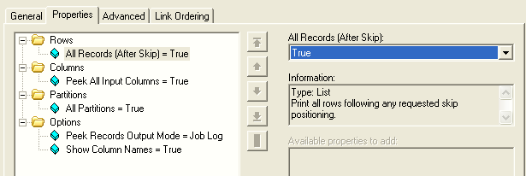
Peek Stage Properties
Output to job log
You can also output from the Peek stage to a file.

Slide 44
Peek Stage
Displays field values
Displayed in job log or sent to a file
Skip records option
Can control number of records to be displayed
Shows data in each partition, labeled 0, 1, 2, …
Useful stub stage for iterative job development
Develop job to a stopping point and check the data
The peek stage will display column values in a job's output messages log.

Slide 45
IBM InfoSphere Information Server
Lesson 2.6 : Adding Job Documentation

Slide 46
Adding Job Documentation
Job Properties
Short and long descriptions
Annotation stage
Added from the Tools Palette
Displays formatted text descriptions on diagram
This documentation is displayed in Manager and Director in addition to the job diagram.

Slide 47
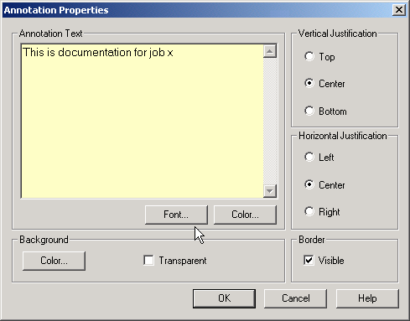
Annotation Stage Properties
You can type in whatever you want; the default text comes from the short description of the jobs properties you entered, if any.
Add one or more Annotation stages to the canvas to document your job.
An Annotation stage works like a text box with various formatting options.
You can optionally show or hide the Annotation stages by pressing a button on the toolbar.
There are two Annotation stages. The Description Annotation stage correlates its text with the Descriptions specified as part of the job properties.

Slide 48
IBM InfoSphere Information Server
Lesson 2.7 : Compiling a Job

Slide 49
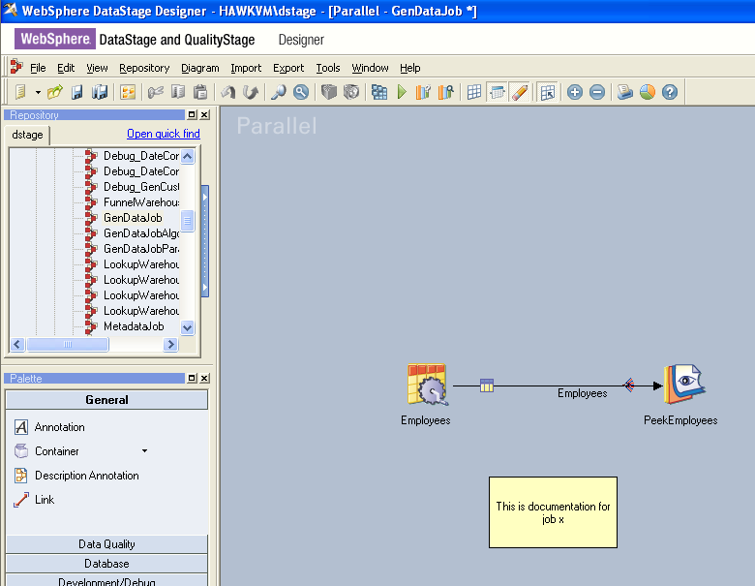
Compiling a Job
Before you can run your job, you must compile it.
To compile it, click File>Compile or click the Compile button on the toolbar.
The Compile Job window displays the status of the compile.
A compile will generate OSH.

Slide 50
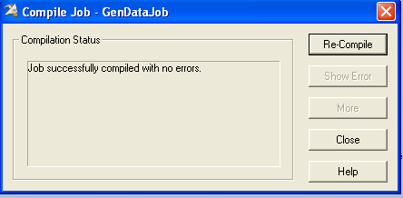
Errors or Successful Message
Click for more info
If an error occurs:
Click Show Error to identify the stage where the error occurred.
This will highlight the stage in error.
Click More to retrieve more information about the error. This can be lengthy for parallel jobs.
Many errors also show up on the diagram if “Show Stage Validation Errors” is turned on.

Slide 51
Unit summary
Having completed this unit, you should be able to:
Design a simple Parallel job in Designer
Define a job parameter
Use the Row Generator, Peek, and Annotation stages in a job
Compile your job
Run your job in Director
View the job log

Slide 52
Q&A
True or False ? Can you import Table Definitions for sequential files with fixed-length record formats?
Which stage can be used to display output data in the job log?
Which stage is used for documenting your job on the job canvas?

Slide 53
Q&A
Yes. Record lengths are determined by the lengths of the individual columns.
Peek stage
Annotation stage

